Slide 1

Stress-free home improvement from the convenience of your smartphone

Slide 2

The Problem
Home Improvement Estimate Process
Connect with contractors
Schedule and
receive estimates
Hire contractor to complete job
Word of mouth
Online
Google
Yelp
Angie’s List
City Search
Phonebook
Call several contractors to schedule estimate
Issues:
Do contractors respond to your calls?
Is the appointment convenient?
Choose a contractor
Issues:
Are you sure you’re paying a fair price?
How do you know your contractor provides quality services?

Slide 3

The Solution
What is Homespree?
Homespree is a mobile and web application that enables homeowners to request competitive estimates from multiple contractors for home services.
Value to Homeowners
Homespree makes the process of hiring a contractor less stressful by providing the right information to make a better informed decision through a simple and convenient platform.
Value to Contractors
Homespree makes the process of connecting with new customers more efficient and effective by providing a repository of quality local leads.

Slide 4
Process Overview
Homespree connects homeowners and contractors in 3 simple steps
1
2
3
Homeowners submit project requests
Contractors bid on the projects
Homeowners choose contractors based on price, rating & reviews

Slide 5
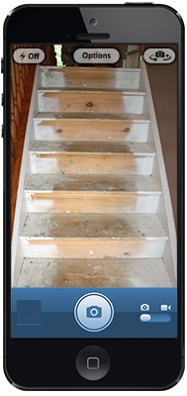
Requesting an Estimate
Category
Homespree offers a wide array of home improvement services. Categories range from painting to landscaping and even cleaning.
Images
Snapping several pictures or recording a video provides contractors with a visual presentation of the request and a good sense of the project scope.
Details
Several details are required to supplement the images and provide a quality estimate. Homespree utilizes direct input from contractors to ensure the right details are captured.

Slide 6
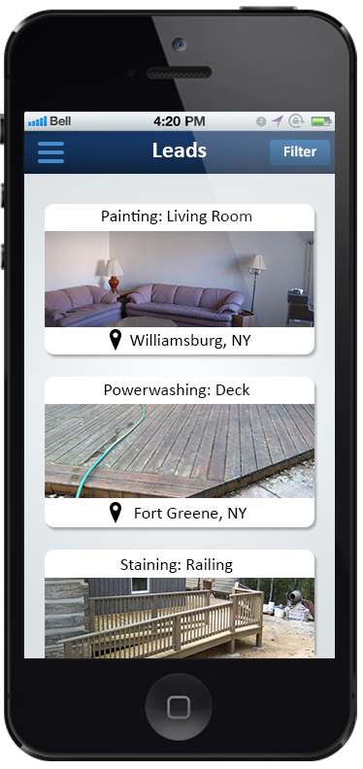
Submitting Bids
Timeline
Homeowners choose the date by which they require the job to be complete enabling Homespree to match them with a contractor that has availability.
Blind Auction
Bids are only visible to the homeowner who has requested the estimate. Contractors bid in a blind auction so as to promote fair pricing.
Review
Homeowners are provided at least 3 competitive bids from pre-screened contractors that best match their project needs within 24 hours.

Slide 7
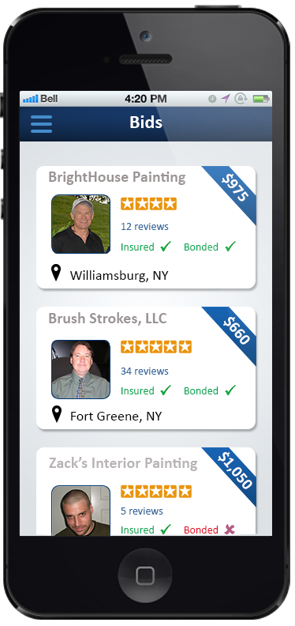
Choosing a Contractor
Portfolio
Contractors are required to upload a portfolio to provide visual examples of the quality of their work.
Ratings and Reviews
Homeowners are prompted to submit ratings and reviews following the completion of their project. Price is only one variable that homeowners factor into the equation to choose a contractor; ratings and reviews are also given significant weight.
Contact
Once a homeowner has chosen a contractor, they are able to contact that contractor through private messaging to schedule a time for final walk-through and/or to begin the job.

Slide 8
Revenue Model
Commissions
Contractors are charged a commission on accepted estimates
Targeted Advertisements
Homespree offers suppliers of building products unique targeted advertising opportunities
Deal Promotion
Homeowners can see which contractors are offering deals in their local area

Slide 9
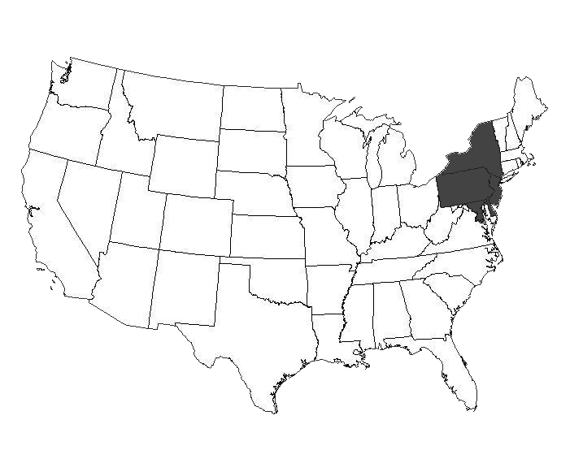
Implementation
Phased Rollout
Win in local markets
Sign up 10 contractors in each service category
Market to local homeowners
Scale to new markets
Implementation Tactics
Convert homeowner leads from Google Ads
Focus on contractors that demonstrate adoption of technology
Contractors will be prescreened by staff and only those that receive approval can join Homespree; require 3 referrals and a portfolio
Partner with other players in the online home space to drive leads

Slide 10









Online Home Improvement Space
Reviews
Tasks
Home Improvement Requests
Home

Slide 11

Competitive Analysis
Company | Bids | App | Photos | Rich Profile | Preferences | Social
 | 3
 | 4
 | Many
 | 1
ü
ü
ü
ü
ü
ü
ü
ü
û
ü
ü
ü
ü
û
û
ü
û
û
û
û

Slide 12
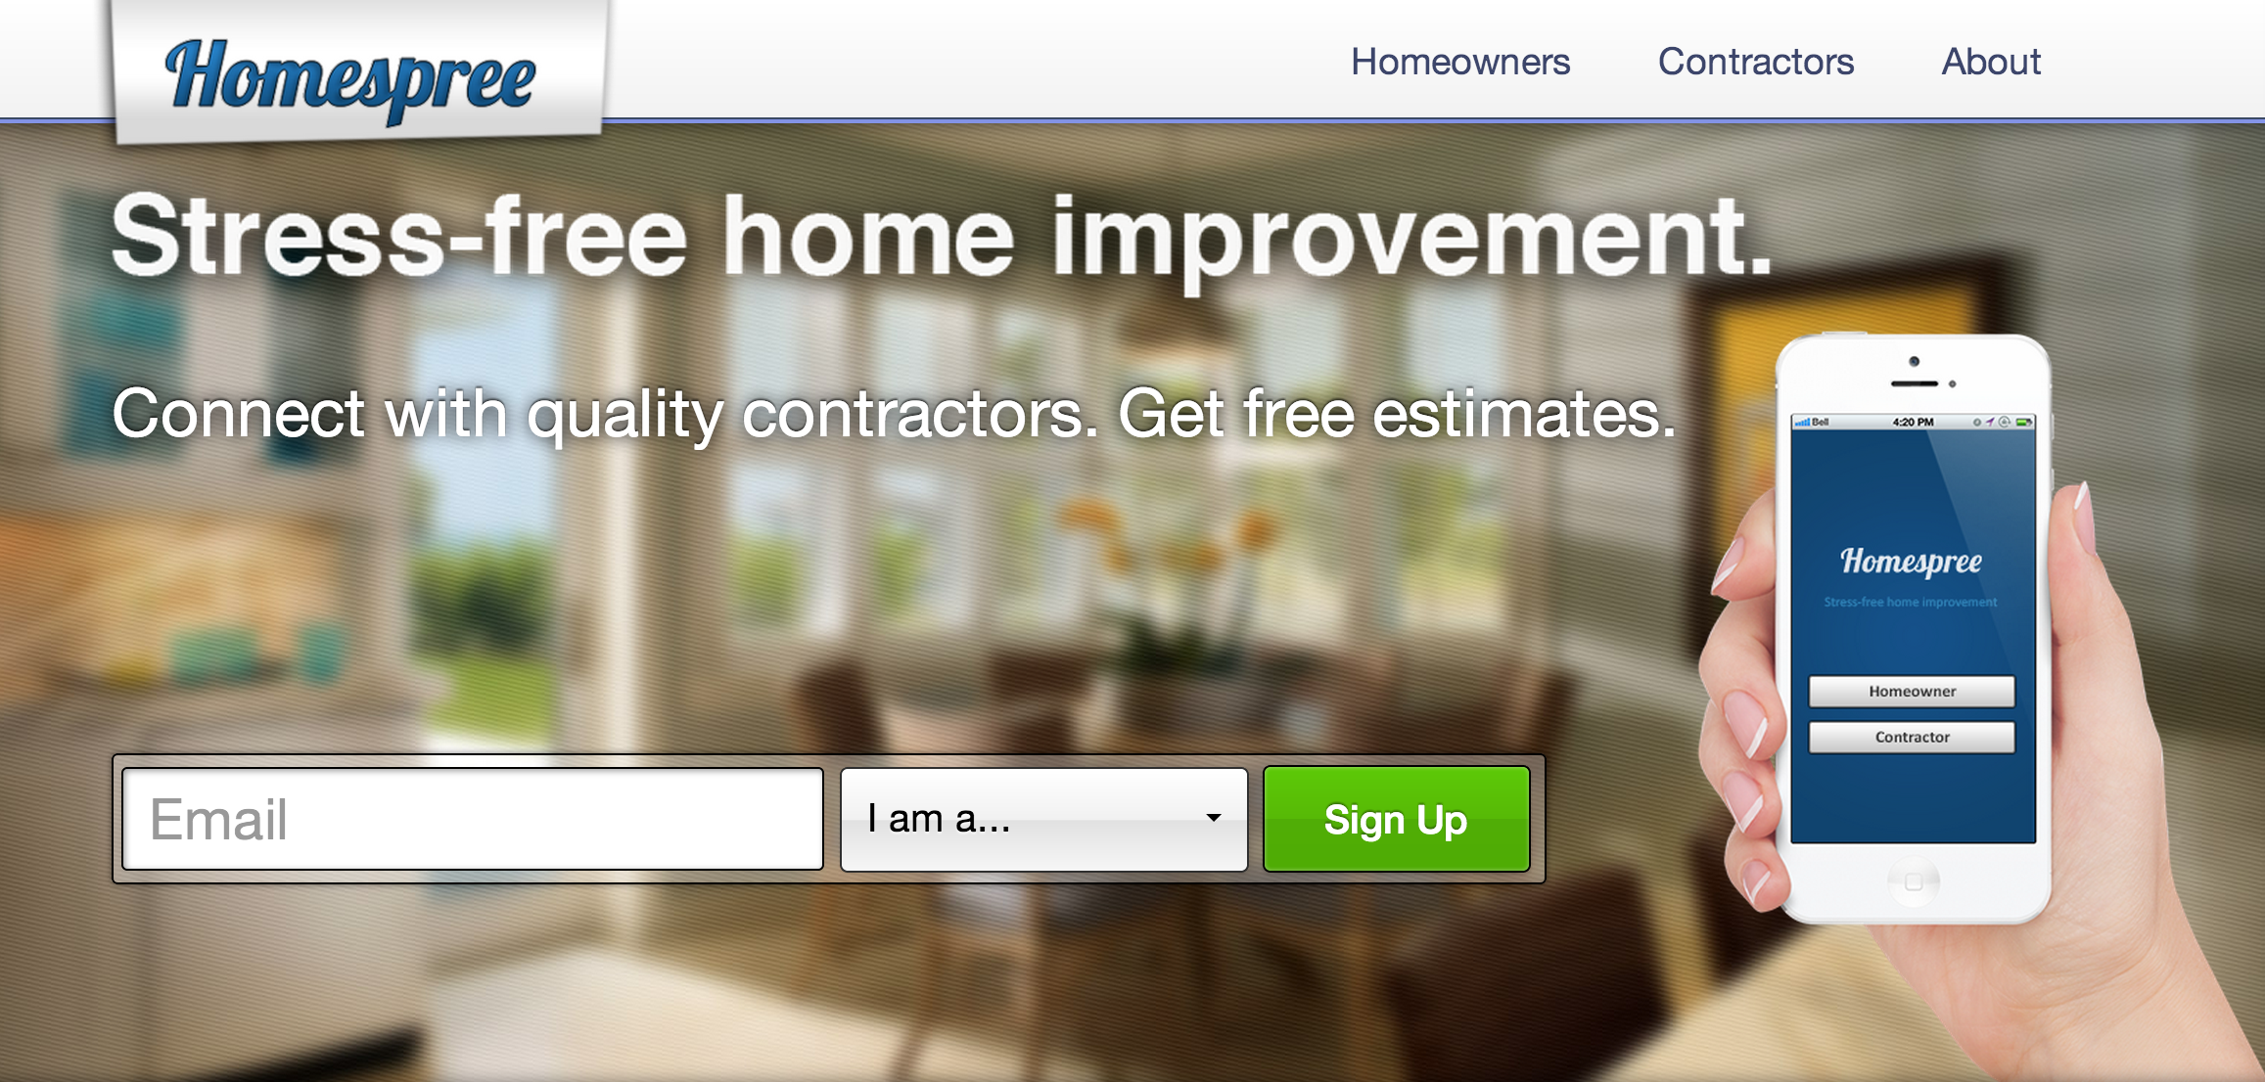
Conclusion
Process of requesting and submitting home improvement estimates is antiquated
Homespree seeks to advance industry by providing a marketplace for home services
Tremendous value to homeowners and contractors
Massive opportunity: 114MM households and 7MM employed in construction industry in the U.S.
Rapid expansion of mobile devices facilitates customer adoption

